Slide 1
CSE 185 Introduction to Computer Vision
Image Filtering:
Spatial Domain

Slide 2
Image filtering
Spatial domain
Frequency domain
Reading: Chapter 3

Slide 3
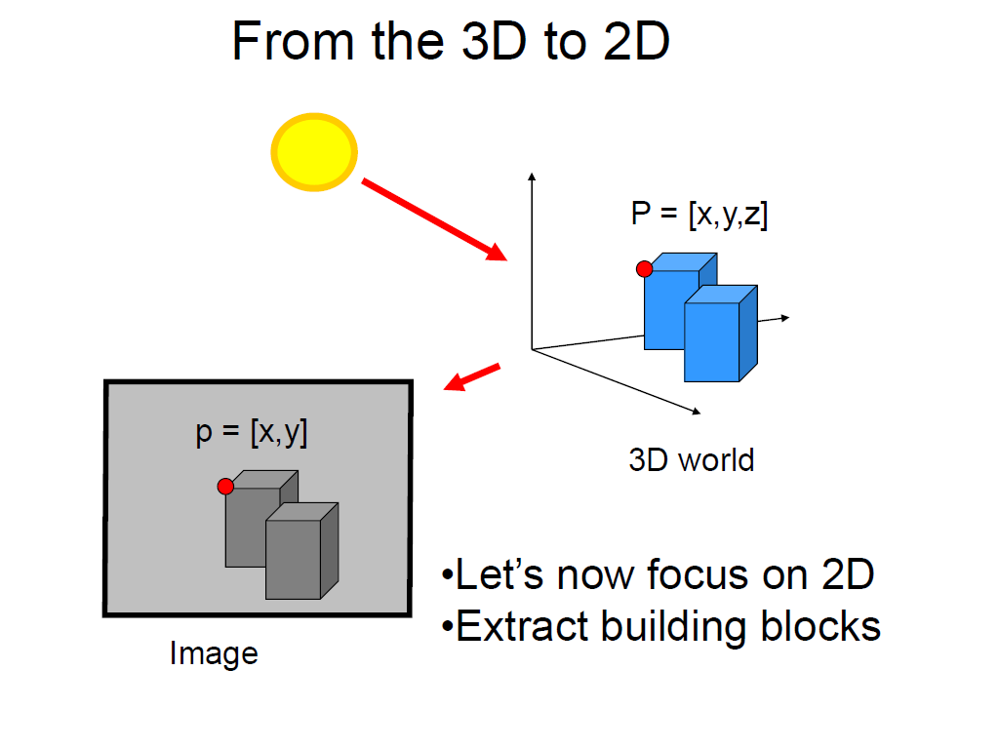
3D world from 2D image

Slide 4
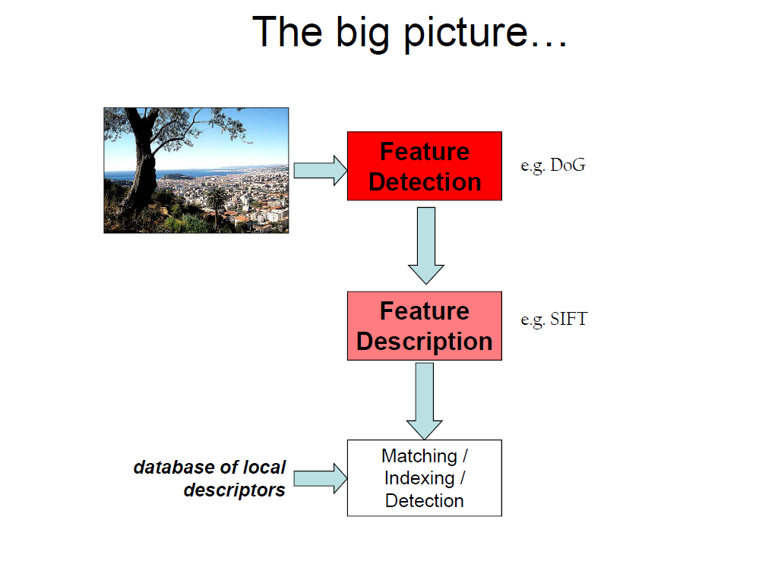
Analysis from local evidence

Slide 5
Image filters
Spatial domain
Filter is a mathematical operation of a grid of numbers
Smoothing, sharpening, measuring texture
Frequency domain
Filtering is a way to modify the frequencies of images
Denoising, sampling, image compression
Templates and image pyramids
Filtering is a way to match a template to the image
Detection, coarse-to-fine registration

Slide 6
Image filtering
Image filtering: compute function (also known as kernel) of local neighborhood at each position
Important tools
Enhance images
Denoise, resize, increase contrast, etc.
Extract information from images
Texture, edges, distinctive points, etc.
Detect patterns
Template matching

Slide 7

Box filter
1
1
1
1
1
1
1
1
1

Slide 8
Image filtering
filter
1
1
1
1
1
1
output
1
1
1
input image
0 | 0 | 0 | 0 | 0 | 0 | 0 | 0 | 0 | 0
0 | 0 | 0 | 0 | 0 | 0 | 0 | 0 | 0 | 0
0 | 0 | 0 | 90 | 90 | 90 | 90 | 90 | 0 | 0
0 | 0 | 0 | 90 | 90 | 90 | 90 | 90 | 0 | 0
0 | 0 | 0 | 90 | 90 | 90 | 90 | 90 | 0 | 0
0 | 0 | 0 | 90 | 0 | 90 | 90 | 90 | 0 | 0
0 | 0 | 0 | 90 | 90 | 90 | 90 | 90 | 0 | 0
0 | 0 | 0 | 0 | 0 | 0 | 0 | 0 | 0 | 0
0 | 0 | 90 | 0 | 0 | 0 | 0 | 0 | 0 | 0
0 | 0 | 0 | 0 | 0 | 0 | 0 | 0 | 0 | 0
 | 0
0 | 0 | 0 | 0 | 0 | 0 | 0 | 0 | 0 | 0
0 | 0 | 0 | 0 | 0 | 0 | 0 | 0 | 0 | 0
0 | 0 | 0 | 90 | 90 | 90 | 90 | 90 | 0 | 0
0 | 0 | 0 | 90 | 90 | 90 | 90 | 90 | 0 | 0
0 | 0 | 0 | 90 | 90 | 90 | 90 | 90 | 0 | 0
0 | 0 | 0 | 90 | 0 | 90 | 90 | 90 | 0 | 0
0 | 0 | 0 | 90 | 90 | 90 | 90 | 90 | 0 | 0
0 | 0 | 0 | 0 | 0 | 0 | 0 | 0 | 0 | 0
0 | 0 | 90 | 0 | 0 | 0 | 0 | 0 | 0 | 0
0 | 0 | 0 | 0 | 0 | 0 | 0 | 0 | 0 | 0
Notes:
ones, divide by 9

Slide 9
Image filtering
filter
1
1
1
1
1
1
output
1
1
1
input image
0 | 0 | 0 | 0 | 0 | 0 | 0 | 0 | 0 | 0
0 | 0 | 0 | 0 | 0 | 0 | 0 | 0 | 0 | 0
0 | 0 | 0 | 90 | 90 | 90 | 90 | 90 | 0 | 0
0 | 0 | 0 | 90 | 90 | 90 | 90 | 90 | 0 | 0
0 | 0 | 0 | 90 | 90 | 90 | 90 | 90 | 0 | 0
0 | 0 | 0 | 90 | 0 | 90 | 90 | 90 | 0 | 0
0 | 0 | 0 | 90 | 90 | 90 | 90 | 90 | 0 | 0
0 | 0 | 0 | 0 | 0 | 0 | 0 | 0 | 0 | 0
0 | 0 | 90 | 0 | 0 | 0 | 0 | 0 | 0 | 0
0 | 0 | 0 | 0 | 0 | 0 | 0 | 0 | 0 | 0
 | 0 | 10
0 | 0 | 0 | 0 | 0 | 0 | 0 | 0 | 0 | 0
0 | 0 | 0 | 0 | 0 | 0 | 0 | 0 | 0 | 0
0 | 0 | 0 | 90 | 90 | 90 | 90 | 90 | 0 | 0
0 | 0 | 0 | 90 | 90 | 90 | 90 | 90 | 0 | 0
0 | 0 | 0 | 90 | 90 | 90 | 90 | 90 | 0 | 0
0 | 0 | 0 | 90 | 0 | 90 | 90 | 90 | 0 | 0
0 | 0 | 0 | 90 | 90 | 90 | 90 | 90 | 0 | 0
0 | 0 | 0 | 0 | 0 | 0 | 0 | 0 | 0 | 0
0 | 0 | 90 | 0 | 0 | 0 | 0 | 0 | 0 | 0
0 | 0 | 0 | 0 | 0 | 0 | 0 | 0 | 0 | 0
Notes:
ones, divide by 9

Slide 10
Image filtering
filter
1
1
1
1
1
1
output
1
1
1
input image
0 | 0 | 0 | 0 | 0 | 0 | 0 | 0 | 0 | 0
0 | 0 | 0 | 0 | 0 | 0 | 0 | 0 | 0 | 0
0 | 0 | 0 | 90 | 90 | 90 | 90 | 90 | 0 | 0
0 | 0 | 0 | 90 | 90 | 90 | 90 | 90 | 0 | 0
0 | 0 | 0 | 90 | 90 | 90 | 90 | 90 | 0 | 0
0 | 0 | 0 | 90 | 0 | 90 | 90 | 90 | 0 | 0
0 | 0 | 0 | 90 | 90 | 90 | 90 | 90 | 0 | 0
0 | 0 | 0 | 0 | 0 | 0 | 0 | 0 | 0 | 0
0 | 0 | 90 | 0 | 0 | 0 | 0 | 0 | 0 | 0
0 | 0 | 0 | 0 | 0 | 0 | 0 | 0 | 0 | 0
 | 0 | 10 | 20
0 | 0 | 0 | 0 | 0 | 0 | 0 | 0 | 0 | 0
0 | 0 | 0 | 0 | 0 | 0 | 0 | 0 | 0 | 0
0 | 0 | 0 | 90 | 90 | 90 | 90 | 90 | 0 | 0
0 | 0 | 0 | 90 | 90 | 90 | 90 | 90 | 0 | 0
0 | 0 | 0 | 90 | 90 | 90 | 90 | 90 | 0 | 0
0 | 0 | 0 | 90 | 0 | 90 | 90 | 90 | 0 | 0
0 | 0 | 0 | 90 | 90 | 90 | 90 | 90 | 0 | 0
0 | 0 | 0 | 0 | 0 | 0 | 0 | 0 | 0 | 0
0 | 0 | 90 | 0 | 0 | 0 | 0 | 0 | 0 | 0
0 | 0 | 0 | 0 | 0 | 0 | 0 | 0 | 0 | 0
Notes:
ones, divide by 9

Slide 11
Image filtering
filter
1
1
1
1
1
1
output
1
1
1
input image
0 | 0 | 0 | 0 | 0 | 0 | 0 | 0 | 0 | 0
0 | 0 | 0 | 0 | 0 | 0 | 0 | 0 | 0 | 0
0 | 0 | 0 | 90 | 90 | 90 | 90 | 90 | 0 | 0
0 | 0 | 0 | 90 | 90 | 90 | 90 | 90 | 0 | 0
0 | 0 | 0 | 90 | 90 | 90 | 90 | 90 | 0 | 0
0 | 0 | 0 | 90 | 0 | 90 | 90 | 90 | 0 | 0
0 | 0 | 0 | 90 | 90 | 90 | 90 | 90 | 0 | 0
0 | 0 | 0 | 0 | 0 | 0 | 0 | 0 | 0 | 0
0 | 0 | 90 | 0 | 0 | 0 | 0 | 0 | 0 | 0
0 | 0 | 0 | 0 | 0 | 0 | 0 | 0 | 0 | 0
 | 0 | 10 | 20 | 30
0 | 0 | 0 | 0 | 0 | 0 | 0 | 0 | 0 | 0
0 | 0 | 0 | 0 | 0 | 0 | 0 | 0 | 0 | 0
0 | 0 | 0 | 90 | 90 | 90 | 90 | 90 | 0 | 0
0 | 0 | 0 | 90 | 90 | 90 | 90 | 90 | 0 | 0
0 | 0 | 0 | 90 | 90 | 90 | 90 | 90 | 0 | 0
0 | 0 | 0 | 90 | 0 | 90 | 90 | 90 | 0 | 0
0 | 0 | 0 | 90 | 90 | 90 | 90 | 90 | 0 | 0
0 | 0 | 0 | 0 | 0 | 0 | 0 | 0 | 0 | 0
0 | 0 | 90 | 0 | 0 | 0 | 0 | 0 | 0 | 0
0 | 0 | 0 | 0 | 0 | 0 | 0 | 0 | 0 | 0
Notes:
ones, divide by 9

Slide 12
Image filtering
filter
1
1
1
1
1
1
output
1
1
1
input image
0 | 0 | 0 | 0 | 0 | 0 | 0 | 0 | 0 | 0
0 | 0 | 0 | 0 | 0 | 0 | 0 | 0 | 0 | 0
0 | 0 | 0 | 90 | 90 | 90 | 90 | 90 | 0 | 0
0 | 0 | 0 | 90 | 90 | 90 | 90 | 90 | 0 | 0
0 | 0 | 0 | 90 | 90 | 90 | 90 | 90 | 0 | 0
0 | 0 | 0 | 90 | 0 | 90 | 90 | 90 | 0 | 0
0 | 0 | 0 | 90 | 90 | 90 | 90 | 90 | 0 | 0
0 | 0 | 0 | 0 | 0 | 0 | 0 | 0 | 0 | 0
0 | 0 | 90 | 0 | 0 | 0 | 0 | 0 | 0 | 0
0 | 0 | 0 | 0 | 0 | 0 | 0 | 0 | 0 | 0
 | 0 | 10 | 20 | 30 | 30
Notes:
ones, divide by 9

Slide 13
Image filtering
filter
1
1
1
1
1
1
output
1
1
1
input image
0 | 0 | 0 | 0 | 0 | 0 | 0 | 0 | 0 | 0
0 | 0 | 0 | 0 | 0 | 0 | 0 | 0 | 0 | 0
0 | 0 | 0 | 90 | 90 | 90 | 90 | 90 | 0 | 0
0 | 0 | 0 | 90 | 90 | 90 | 90 | 90 | 0 | 0
0 | 0 | 0 | 90 | 90 | 90 | 90 | 90 | 0 | 0
0 | 0 | 0 | 90 | 0 | 90 | 90 | 90 | 0 | 0
0 | 0 | 0 | 90 | 90 | 90 | 90 | 90 | 0 | 0
0 | 0 | 0 | 0 | 0 | 0 | 0 | 0 | 0 | 0
0 | 0 | 90 | 0 | 0 | 0 | 0 | 0 | 0 | 0
0 | 0 | 0 | 0 | 0 | 0 | 0 | 0 | 0 | 0
 | 0 | 10 | 20 | 30 | 30
?
Notes:
ones, divide by 9

Slide 14
Image filtering
filter
1
1
1
1
1
1
output
1
1
1
input image
0 | 0 | 0 | 0 | 0 | 0 | 0 | 0 | 0 | 0
0 | 0 | 0 | 0 | 0 | 0 | 0 | 0 | 0 | 0
0 | 0 | 0 | 90 | 90 | 90 | 90 | 90 | 0 | 0
0 | 0 | 0 | 90 | 90 | 90 | 90 | 90 | 0 | 0
0 | 0 | 0 | 90 | 90 | 90 | 90 | 90 | 0 | 0
0 | 0 | 0 | 90 | 0 | 90 | 90 | 90 | 0 | 0
0 | 0 | 0 | 90 | 90 | 90 | 90 | 90 | 0 | 0
0 | 0 | 0 | 0 | 0 | 0 | 0 | 0 | 0 | 0
0 | 0 | 90 | 0 | 0 | 0 | 0 | 0 | 0 | 0
0 | 0 | 0 | 0 | 0 | 0 | 0 | 0 | 0 | 0
 | 0 | 10 | 20 | 30 | 30
 |  |  |  | 50
?
Notes:
ones, divide by 9

Slide 15
Image filtering
filter
1
1
1
1
1
1
output
1
1
1
input image
0 | 0 | 0 | 0 | 0 | 0 | 0 | 0 | 0 | 0
0 | 0 | 0 | 0 | 0 | 0 | 0 | 0 | 0 | 0
0 | 0 | 0 | 90 | 90 | 90 | 90 | 90 | 0 | 0
0 | 0 | 0 | 90 | 90 | 90 | 90 | 90 | 0 | 0
0 | 0 | 0 | 90 | 90 | 90 | 90 | 90 | 0 | 0
0 | 0 | 0 | 90 | 0 | 90 | 90 | 90 | 0 | 0
0 | 0 | 0 | 90 | 90 | 90 | 90 | 90 | 0 | 0
0 | 0 | 0 | 0 | 0 | 0 | 0 | 0 | 0 | 0
0 | 0 | 90 | 0 | 0 | 0 | 0 | 0 | 0 | 0
0 | 0 | 0 | 0 | 0 | 0 | 0 | 0 | 0 | 0
 | 0 | 10 | 20 | 30 | 30 | 30 | 20 | 10
 | 0 | 20 | 40 | 60 | 60 | 60 | 40 | 20
 | 0 | 30 | 60 | 90 | 90 | 90 | 60 | 30
 | 0 | 30 | 50 | 80 | 80 | 90 | 60 | 30
 | 0 | 30 | 50 | 80 | 80 | 90 | 60 | 30
 | 0 | 20 | 30 | 50 | 50 | 60 | 40 | 20
 | 10 | 20 | 30 | 30 | 30 | 30 | 20 | 10
 | 10 | 10 | 10 | 0 | 0 | 0 | 0 | 0

Slide 16
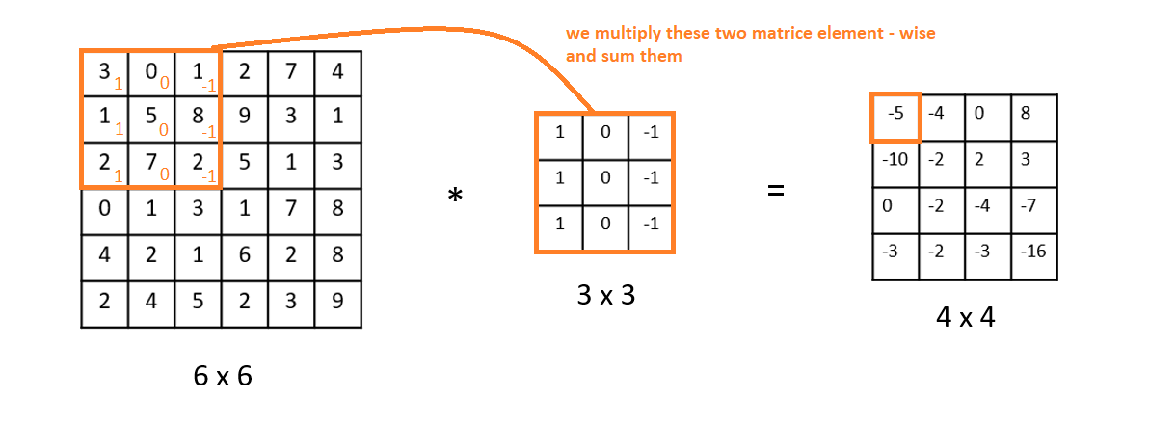
Example
3*1+0*0+1*(-1)+1*1+5*0+8*(-1)+2*1+7*0+2*(-1)=-5
convert image and filter mask into vectors and apply dot product
Convolution of a 6×6 matrix with a 3×3 matrix.
As a result we get a 4×4 matrix.
See http://datahacker.rs/edge-detection/

Slide 17
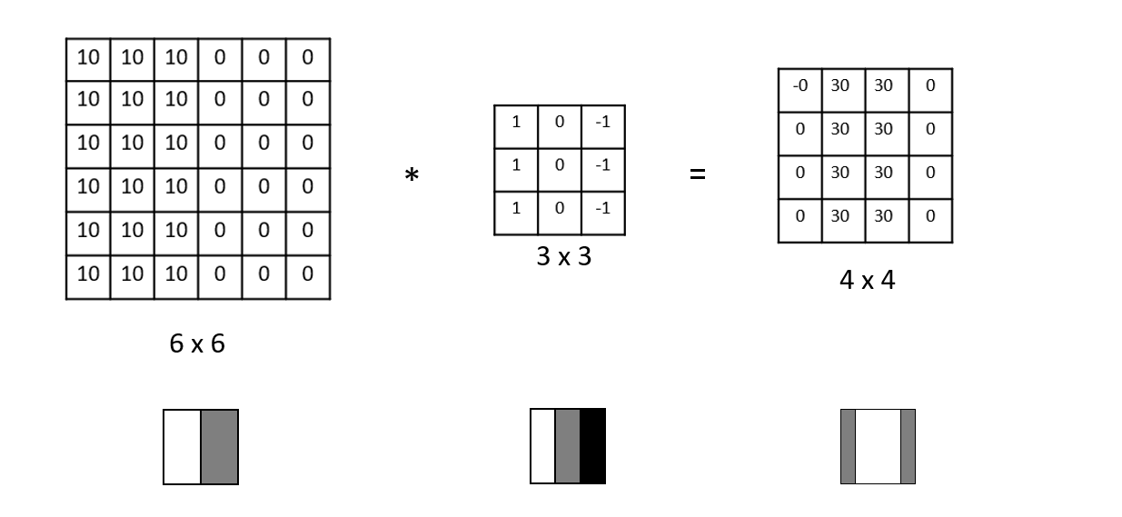
Edge Detection
Edge detection – an original image (left), a filter (in the middle), a result of a convolution (right)

Slide 18
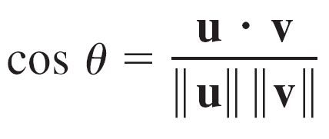
Dot product
Find the angle between
u = ⟨4, 3⟩ and v = ⟨3, 5⟩
Solution:
When do two vectors have maximal value in dot product?
Consider convolution/filter in a similar way
Consider a filter as a probe to infer response in an image

Slide 19
Box filter
What does it do?
Replaces each pixel with an average of its neighborhood
Achieve smoothing effect (remove sharp features)
1
1
1
1
1
1
1
1
1

Slide 20
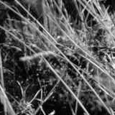
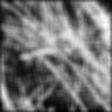
Smoothing with box filter

Slide 21
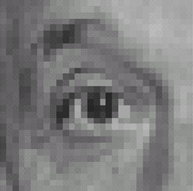
Practice with linear filters
0
0
0
?
0
1
0
0
0
0
Original

Slide 22
Practice with linear filters
0
0
0
0
1
0
0
0
0
Original
Filtered
(no change)

Slide 23
Practice with linear filters
0
0
0
?
0
0
1
0
0
0
Original

Slide 24
Practice with linear filters
0
0
0
0
0
1
0
0
0
Original
Shifted left
By 1 pixel

Slide 25

Practice with linear filters
0
0
0
-
1
1
1
?
0
2
0
1
1
1
0
0
0
1
1
1
(Note that filter sums to 1)
Original

Slide 26
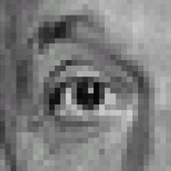
Practice with linear filters
0
0
0
-
1
1
1
0
2
0
1
1
1
0
0
0
1
1
1
Original
Sharpening filter
Accentuates differences with local average

Slide 27
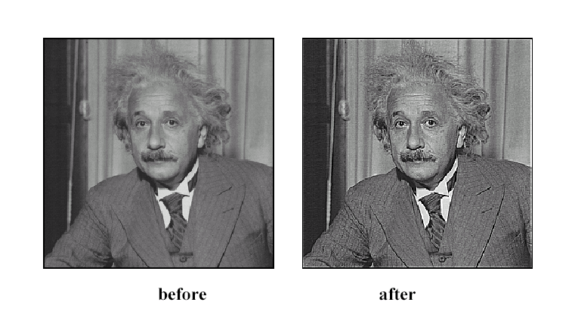
Sharpening

Slide 28
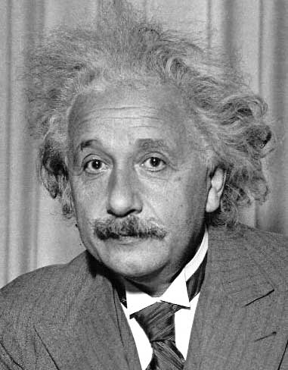
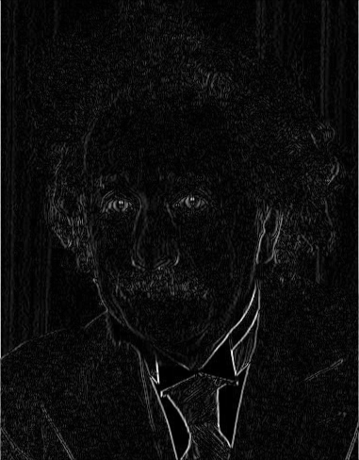
Sobel filter
1
1
1
1
1
0
1
0
0
0
0
1
1
1
1
1
1
1
1
1
0
1
0
0
0
0
0
0
0
0
1
1
1
1
1
0
1
0
0
0
0
1
0
0
0
1
0
-1
2
0
-2
1
0
-1
Sobel
Vertical Edge
(absolute value)
See https://www.youtube.com/watch?v=am36dePheDc

Slide 29
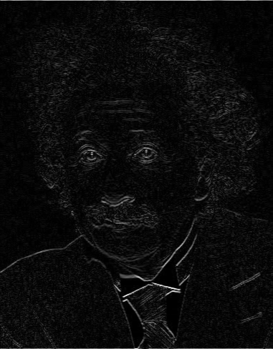
Sobel filter
1
2
1
0
0
0
-1
-2
-1
Sobel
Horizontal Edge
(absolute value)
Notes:
Questions at this point?

Slide 30
Synthesize motion blur
I = imread('cameraman.tif'); subplot(2,2,1);imshow(I);title('Original Image');
H = fspecial('motion',20,45);
MotionBlur = imfilter(I,H,'replicate');
subplot(2,2,2);imshow(MotionBlur);title('Motion Blurred Image');
H2 = fspecial('disk',10);
blurred2 = imfilter(I,H2,'replicate');
subplot(2,2,3);imshow(blurred2);title('Blurred Image');
H3 = fspecial('gaussian', [10 10], 2);
blurred3 = imfilter(I,H3, 'replicate');
subplot(2,2,4);imshow(blurred3);title('Gaussian Blurred Image');

Slide 31
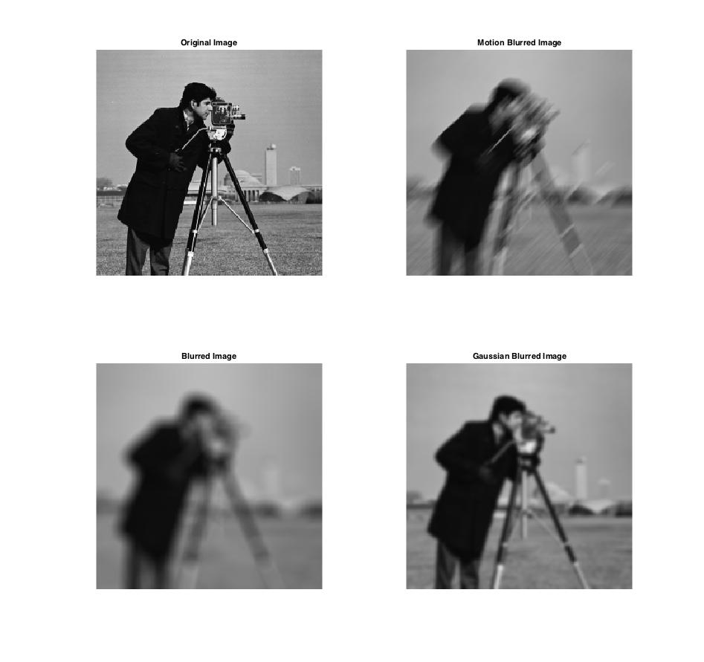

Slide 32
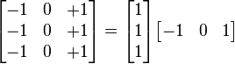
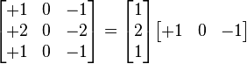
Sample code
Prewitt filter
I=imread('cameraman.tif');
Hpr=fspecial('prewitt');
Hso=fspecial('sobel');
fHpr=imfilter(I,Hpr);
fHso=imfilter(I,Hso);
fHso2=imfilter(I,Hso');
subplot(2,2,1);imshow(I); title('Original Image')
subplot(2,2,2); imshow(fHpr); title('Prewitt filter');
subplot(2,2,3); imshow(fHso); title('Sobel filter - horizontal');
subplot(2,2,4); imshow(fHso2); title('Sobel filter - vertical');
Sobel filter

Slide 33
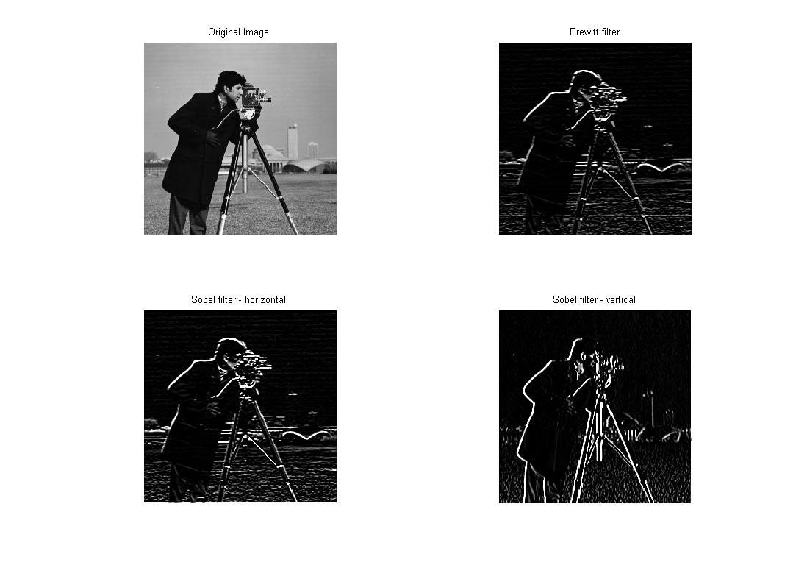

Slide 34
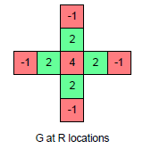
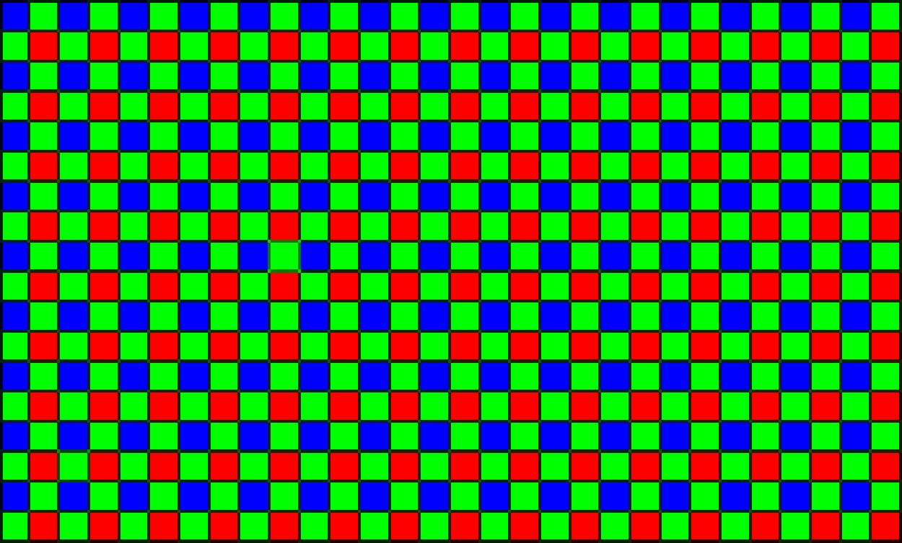
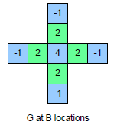
Demosaicing
How can we compute an R, G, and B value for every pixel?

Slide 35
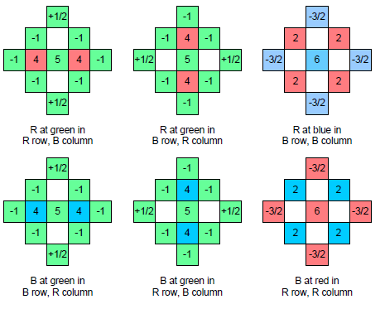
Demosaicing
How can we compute an R, G, and B value for every pixel?

Slide 36
Filtering vs. convolution
g=filter
f=image
2d filtering
h=filter2(g,f); or h=imfilter(f,g);
2d convolution
h=conv2(g,f);

Slide 37
Key properties of linear filters
Linearity:
filter(f₁ + f₂) = filter(f₁) + filter(f₂)
Shift invariance: same behavior regardless of pixel location
filter(shift(f)) = shift(filter(f))
Any linear, shift-invariant operator can be represented as a convolution
Notes:
f is image

Slide 38
More properties
Commutative: a * b = b * a
Conceptually no difference between filter and signal
But particular filtering implementations might break this equality
Associative: a * (b * c) = (a * b) * c
Often apply several filters one after another: (((a * b₁) * b₂) * b₃)
This is equivalent to applying one filter: a * (b₁ * b₂ * b₃)
Distributes over addition: a * (b + c) = (a * b) + (a * c)
Scalars factor out: ka * b = a * kb = k (a * b)
Identity: unit impulse e = [0, 0, 1, 0, 0], a * e = a

Slide 39
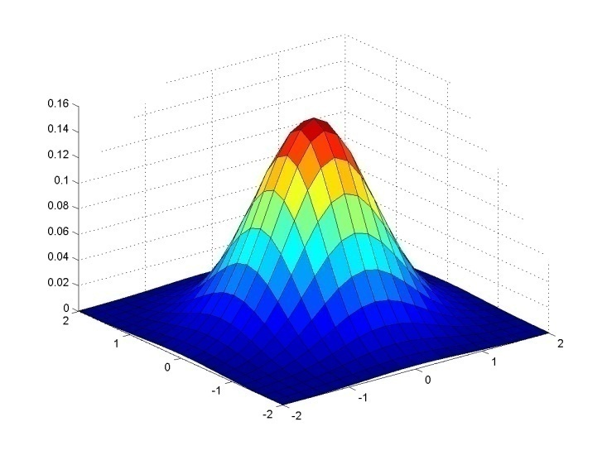
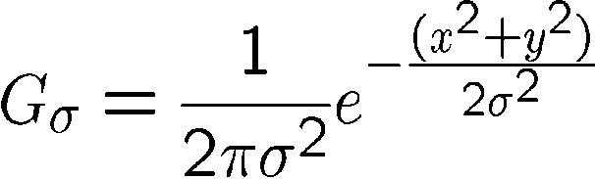
Gaussian filter
Weight contributions of neighboring pixels by nearness
0.003 0.013 0.022 0.013 0.003
0.013 0.059 0.097 0.059 0.013
0.022 0.097 0.159 0.097 0.022
0.013 0.059 0.097 0.059 0.013
0.003 0.013 0.022 0.013 0.003
5 x 5, σ = 1
Notes:
e^0 = 1, e^-1 = .37, e^-2 = .14, etc.

Slide 40

Smoothing with Gaussian filter

Slide 41
Smoothing with box filter

Slide 42

Gaussian filters
Notes:
Linear vs. quadratic in mask size

Slide 43
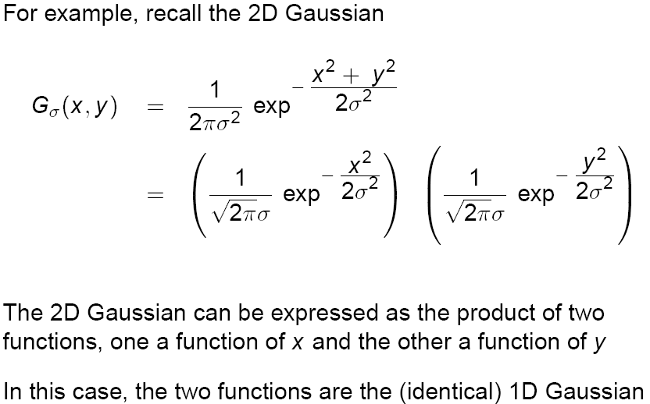
Separability of Gaussian filter

Slide 44
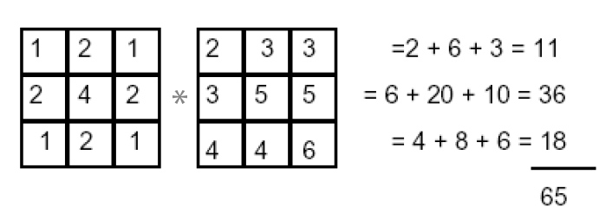
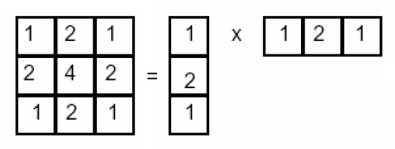
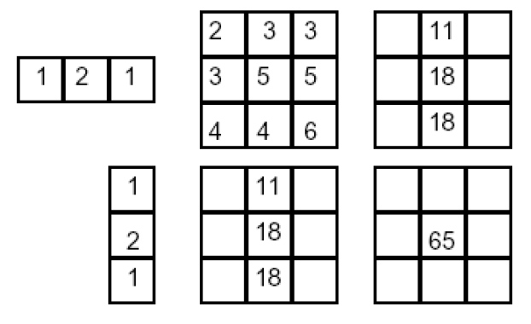
Separability example
filter
image
2D convolution (center location only)
The filter factors into a product of 1D filters:
Perform convolution along rows:
*
=
Followed by convolution along the remaining column:
*
=

Slide 45
Separability
Why is separability useful in practice?
Filtering an M-by-N image with a P-by-Q kernel requires roughly MNPQ multiples and adds.
For a separable filter, it requires
MNP multiples and adds for the first step
MNQ multiples and adds for the second step
MN(P+Q) multiples and adds
For a 9-by-9 filter, a theoretical speed-up of 4.5

Slide 46
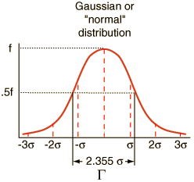
Practical matters
How big should the filter be?
Values at edges should be near zero
Rule of thumb for Gaussian: set filter half-width to about 2.4 (or 3) σ

Slide 47
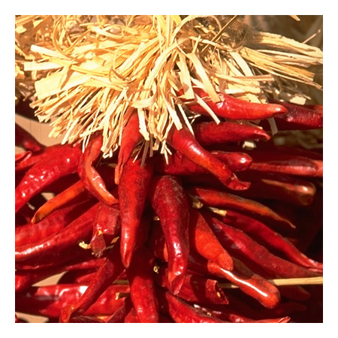
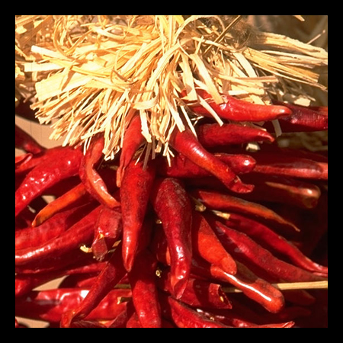




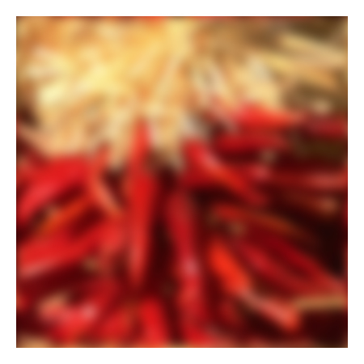



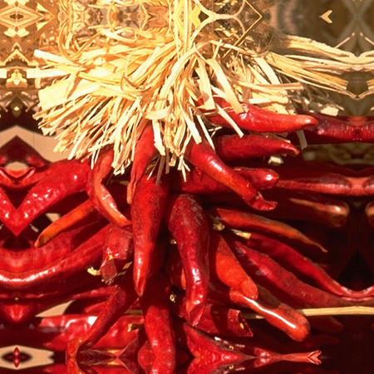


Practical matters
What about near the image boundary?
the filter window falls off the extent of the image
need to extrapolate
methods:
clip filter (black)
wrap around
copy edge
reflect across edge

Slide 48
Practical matters
Q?
methods (MATLAB):
clip filter (black): imfilter(f, g, 0)
wrap around: imfilter(f, g, ‘circular’)
copy edge: imfilter(f, g, ‘replicate’)
reflect across edge: imfilter(f, g, ‘symmetric’)

Slide 49
Practical matters
What is the size of the output?
MATLAB: filter2(g, f, shape) g: filter, f:image
shape = ‘full’: output size is sum of sizes of f and g
shape = ‘same’: output size is same as f (default setting)
shape = ‘valid’: output size is difference of sizes of f and g
full
same
valid
g
g
g
g
f
f
f
g
g
g
g
g
g
g
g

Slide 50
Median filters
A Median Filter operates over a window by selecting the median intensity in the window.
What advantage does a median filter have over a mean filter?
Is a median filter a kind of convolution?
Notes:
Better at salt’n’pepper noise
Not convolution: try a region with 1’s and a 2, and then 1’s and a 3

Slide 51
Comparison: salt and pepper noise

Slide 52

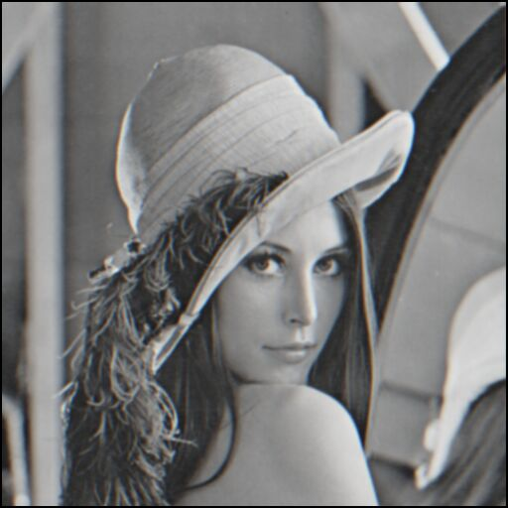
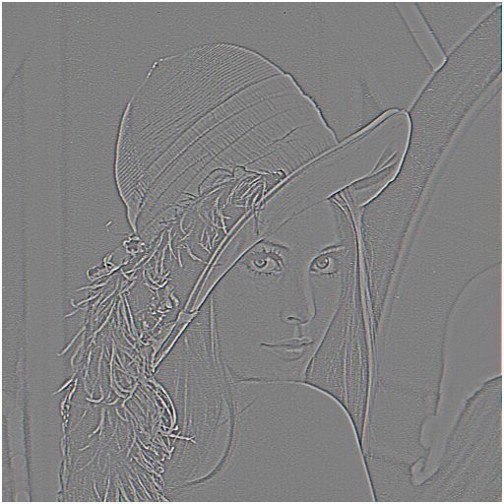

Sharpening revisited
What does blurring take away?
–
=
original
smoothed (5x5)
detail
Let’s add it back:
+ α
=
original
detail
sharpened

Slide 53

Take-home messages
Linear filtering is sum of dot product at each position
Can smooth, sharpen, translate (among many other uses)
Be aware of details for filter size, extrapolation, cropping
1
1
1
1
1
1
1
1
1

Slide 54
Practice questions
Write down a 3x3 filter that returns a positive value if the average value of the 4-adjacent neighbors is less than the center and a negative value otherwise
Write down a filter that will compute the gradient in the x-direction:
gradx(y,x) = im(y,x+1)-im(y,x) for each x, y

